Slide 1

Electric Storm
HackYSU2020

Slide 2

TEAM
Members
Marquis rosa
Seth bucan
Jahein wiley
Elizabeth Daley
Sarah Hunt

Slide 3
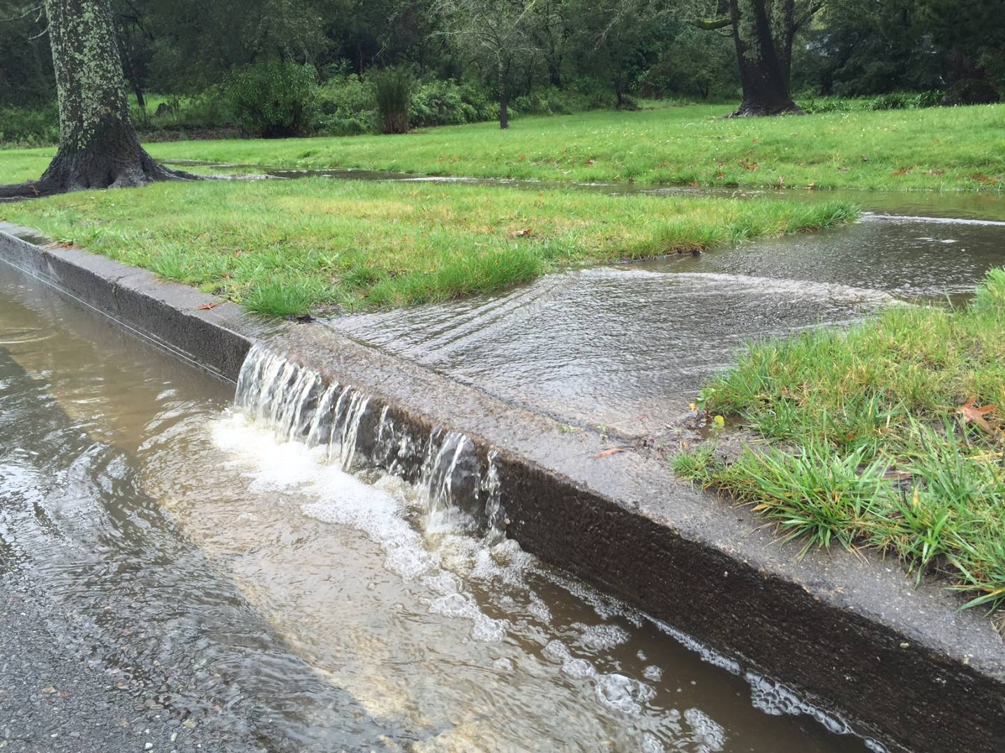
Pitch
We are here to pitch a way to produce energy and save the county money using the storm drain system, and run off water. A supplemental system that would reduce the energy required produced by the coal, and nuclear plants on the grid.

Slide 4
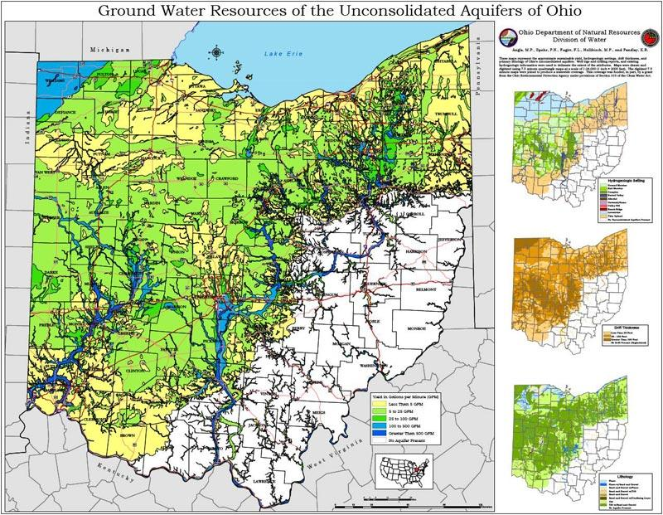
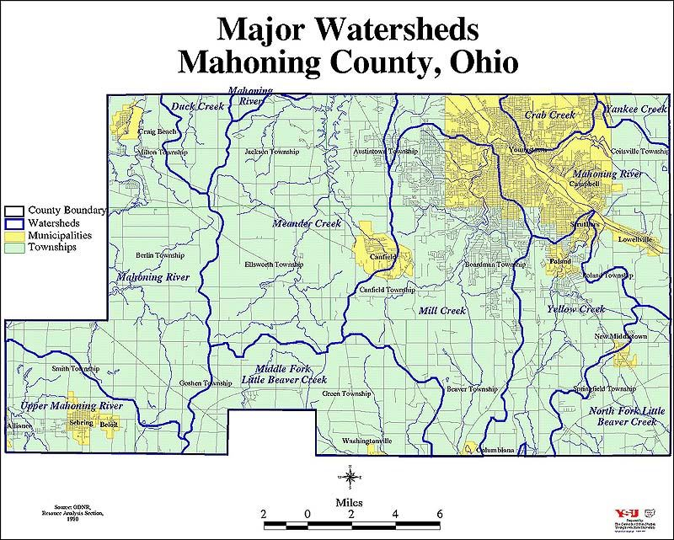
Ecosystem
Ohio is abundant in water and elevation changes

Slide 5
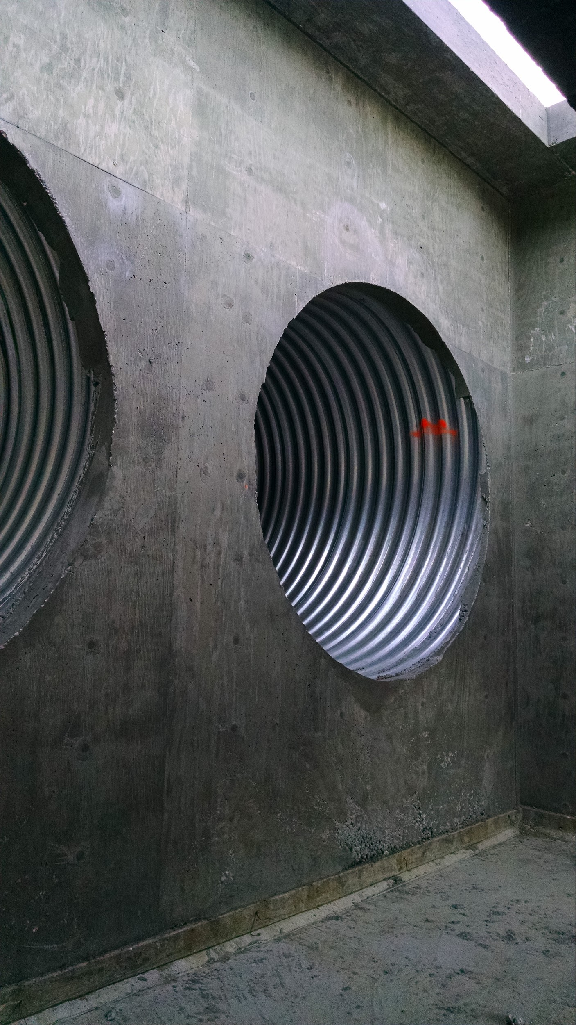
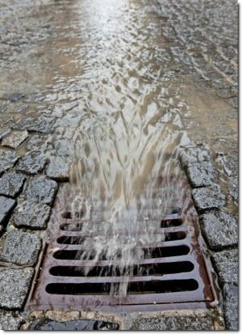
Implementation
Installing volts in to the storm drains allowing for the installation of turbines, and controles so the water collected moves through the turbines creating electricity

Slide 6
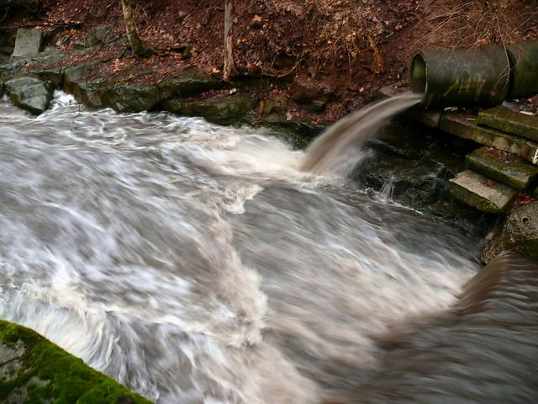
Eco friendly
utalieds unused water
Low admissions
Small carbon footprint
Does not harm wildlife

Slide 7
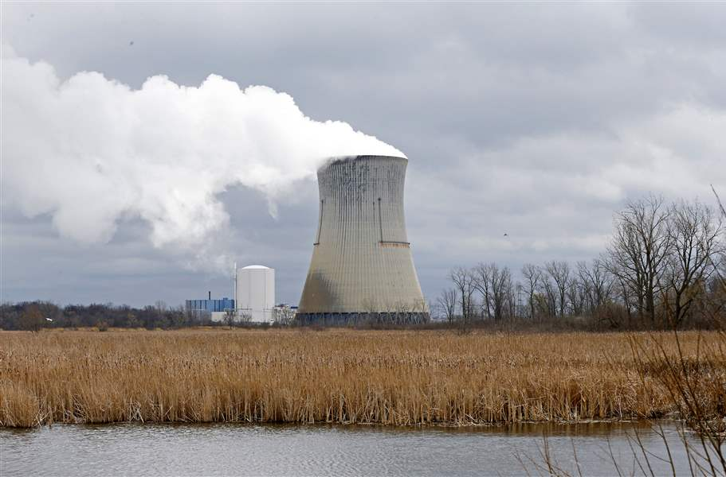
Cost
The adv home uses 867 kilowatt hrs per month, and 10404 kilowatt hrs per year
For the 98,052 houses in mahoning county use 1,020,133,008 kilowatt hrs per year
The current system cost per year $122,415,960.96.
To produce the same amount of energy as the Mahoning county puts out annually you would need 4657 generators running continuously for a year. With a initial investment
Even though at a initial cost of 849,995,040

Slide 8
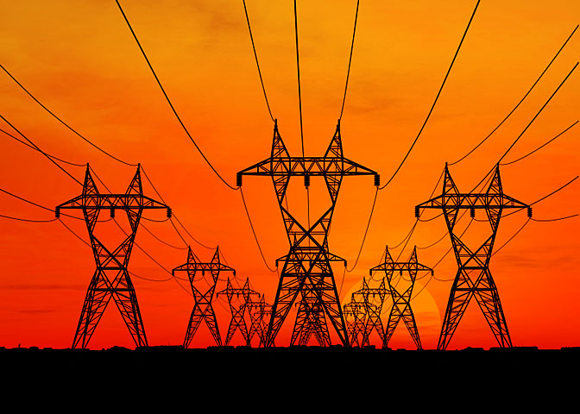
Returns of Interest
The turbines last 25 years over that period the county would save $2,210403,384.
Notes:
25% of the generators would produce 25% of the energy with returns starting in 2 years.

Slide 9
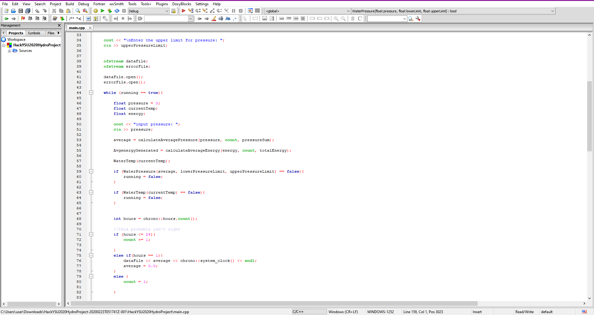
Programing

Slide 10
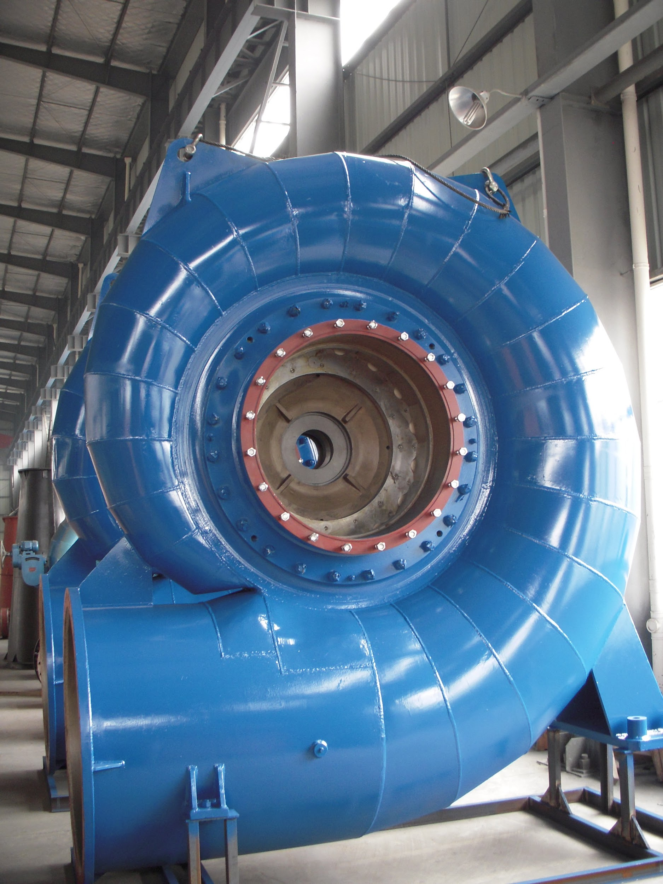
Existing Elements
turbines that can be bought
Storm drain system that are pre existing
runoff water that forms naturally

Slide 11
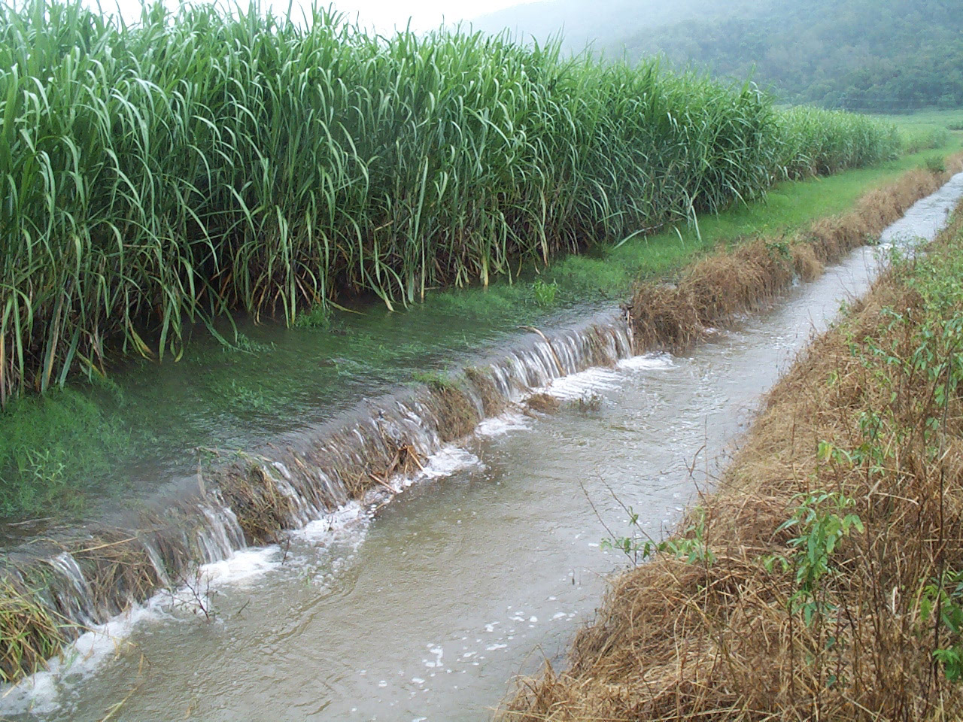
Benefits
A low cost high efficiency system
Low maintenance
eco friendly
High return on interest

